Slide 1

Wörterbuch
Why use a dictionary?
to look up new words
to check spellings
to save asking the teacher
to find out genders or plurals

Slide 2
How is the dictionary organised?
In two halves, German-to-English and English-to-German
Headwords (in colour) = the words you are looking up
Words at top of page = the first and last entry on each page
Entries in alphabetical order

Slide 3
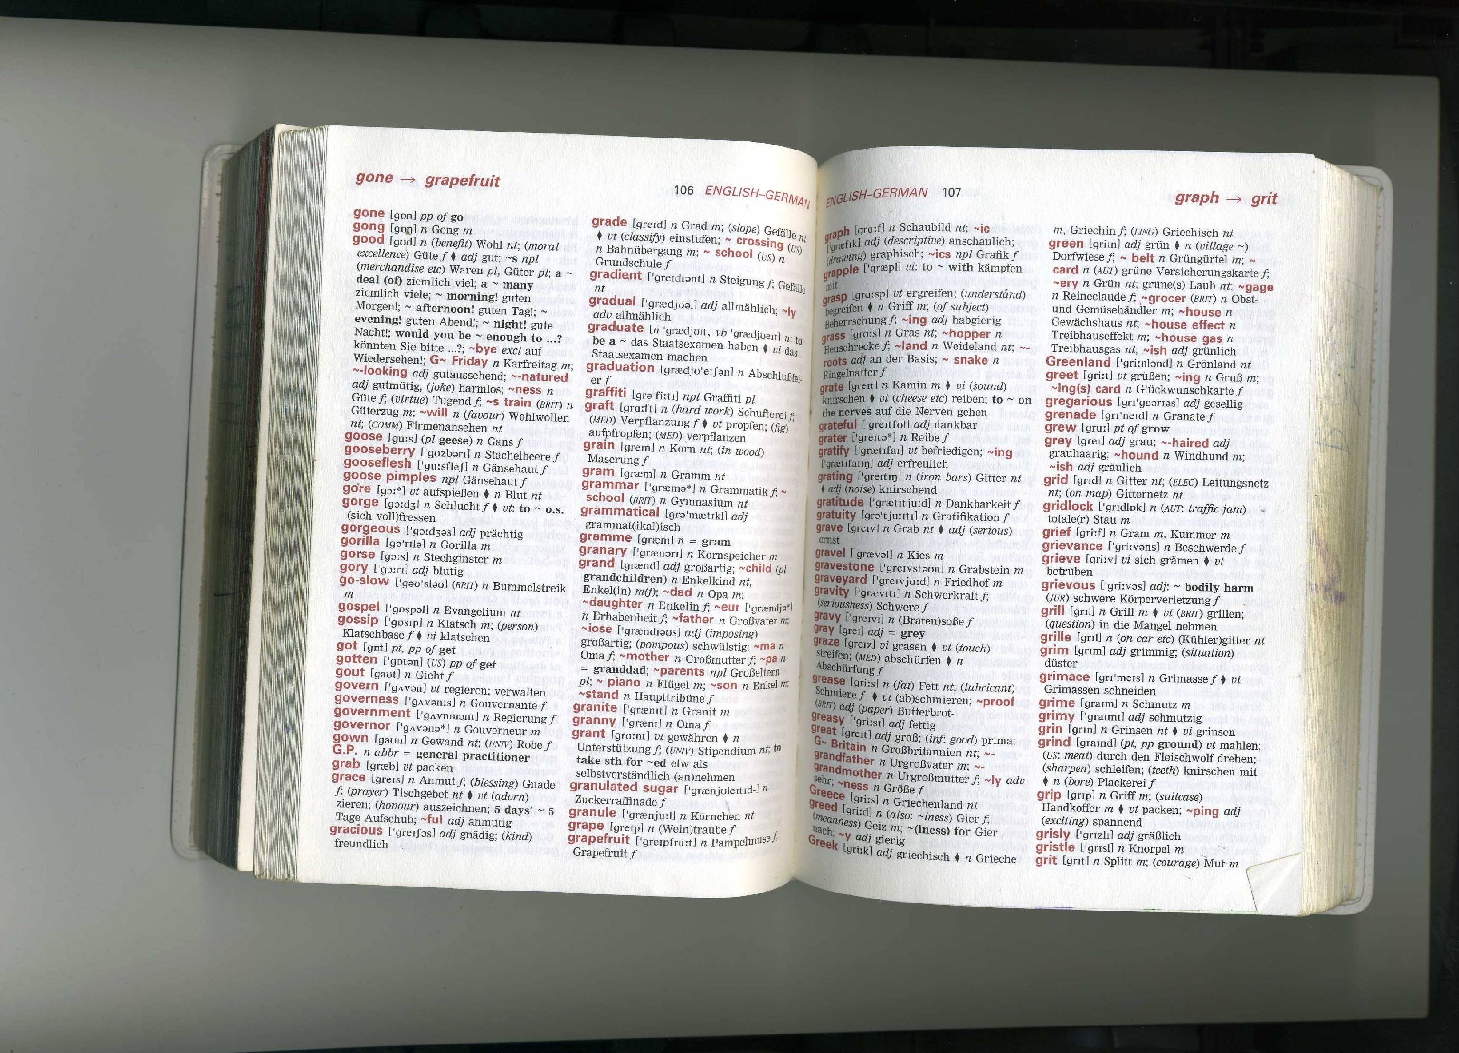

Slide 4
Put the following in alphabetical order
Bonn
Bochum
Bielefeld
Bamberg
Baden-Baden
Bayern
Brandenburg
Berlin
Baden-Baden
Bamberg
Bayern
Berlin
Bielefeld
Bochum
Bonn
Brandenburg

Slide 5


Write down 6 forms of transport
Now look them all up in the German-English part of the dictionary
Time how long it takes you
Did you find them all?
Did you spell them all correctly?
Did it take longer than you expected?

Slide 6

Understanding a dictionary entry
Look up ‘Zug’ in the German-English part.
Headword Zug – the word you wanted
[tsu:k] phonetic spelling, ie. pronunciation
(-(e)s,“e) the last bit of this tells us the plural so Zug will become Züge
m = masculine, so it is a der word
(EISENB) this tells us the context or usage of the word, see Abreviations p.x (Eisenbahn = railways)
Look for other meanings of Zug
Other abbreviations: n = noun, adj = adjective, vi/vt = verb

Slide 7
Now look up Sport in the German section
Look at the words in blue after the squiggly lines ~
In each case, ~ stands for Sport – why?
Make a list of the words beginning with Sport and what they mean
Look at s~lich. Why is there a small s at the beginning?
What does this tell us?
You will not always find the word you want as a headword
The word you want may not be written out in full – you need to add it back together, eg Sportschuh

Slide 8

Have you got the right word?
Look up the English word for ‘what you eat at the end of a meal’
What German word did you find?
Which English word did you use?
Now go to the German section and look up Nachtisch and Wüste to decide which is best
Nachtisch refers you to Nachspeise so you need to look that up too
So what did you do wrong if you got Wüste?
If you looked up Nachtisch and got ‘a bedside table’, what did you do wrong?

